Slide 1

Web scraping to gain company insights
- Sejal

Slide 2
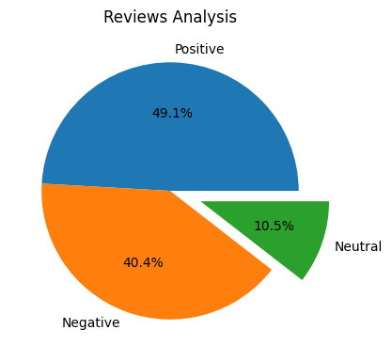
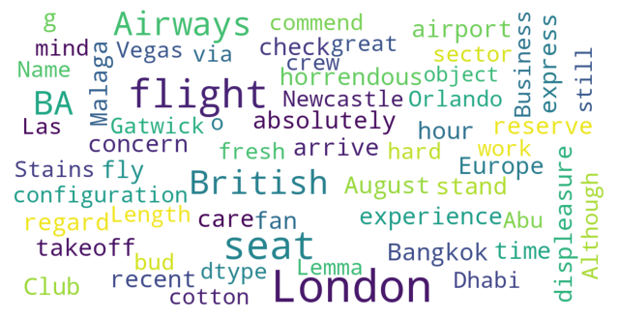
Insights From Customer Reviews
From cleaning 1000 reviews given by the customers, we obtained
Positive Reviews - 491
Negative Reviews - 404
Neutral Reviews – 105

